Slide 1
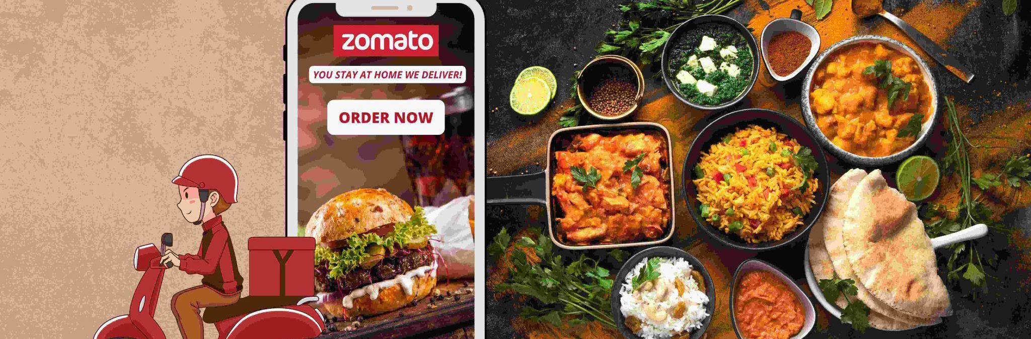
ZOMATO ORDER & RESTAURANT ANALYSIS
FOOD & BEVERAGE, BUSINESS ANALYTICS
USING POWER BI

Slide 2
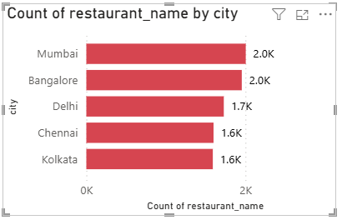
1.NO.OF RESTAURANTS PER CITY
City with more restaurant is MUMBAI.
KOLKATA has least numbers

Slide 3
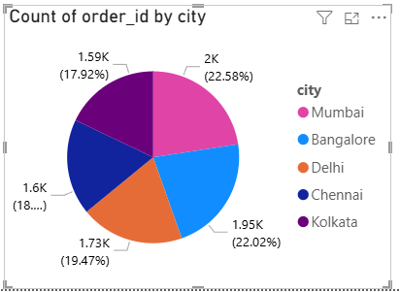
2.PERCENTAGE OF ORDERS
MUMBAI has 22.58% of orders in total.
KOLKATA receives less no.of orders

Slide 4
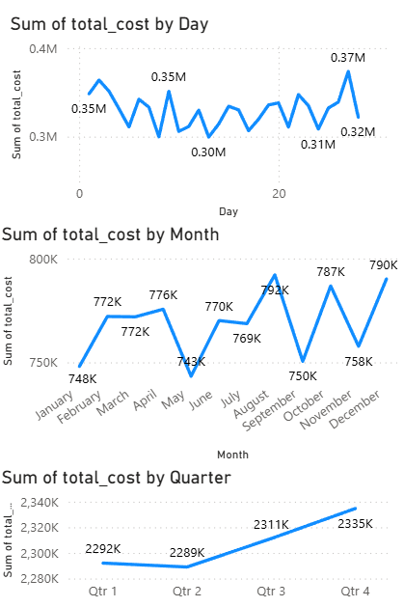
3.ORDER AMOUNT OVER TIME
ORDER BY DAY: month end
ORDER BY MONTH: September,
December
ORDER BY QUARTER: Quarter 4

Slide 5
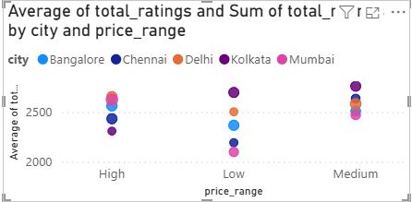
4.FACTORS AFFECTING AVG RATINGS
Premium restaurants tend to achieve better customer ratings across major cities.

Slide 6
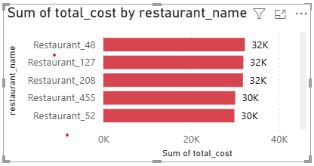
5.TOP RESTAURANTS BY REVENUE
Revenue distribution among top 5 is relatively close, showing healthy competition among leading restaurants

Slide 7
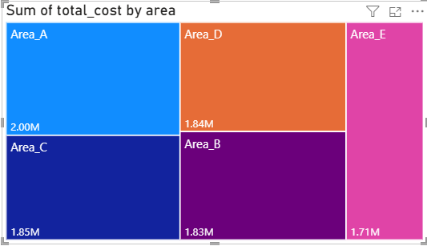
6.REVENUE BY AREA
Area A has stronger business activity and higher customer spending.

Slide 8
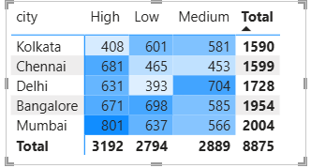
7.ORDER DENSITY BY CITY
High order density in MUMBAI remains as major business and revenue hubs.

Slide 9
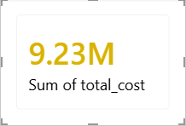
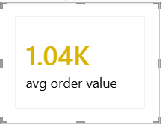
8.KPI CARDS
Strong overall revenue performance across all cities.
Healthy avg order value reflects stable customer spending.

Slide 10
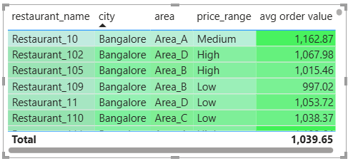
9.RESTAURANT WISE SALES
Sales performance highlights the key revenue driving business.

Slide 11
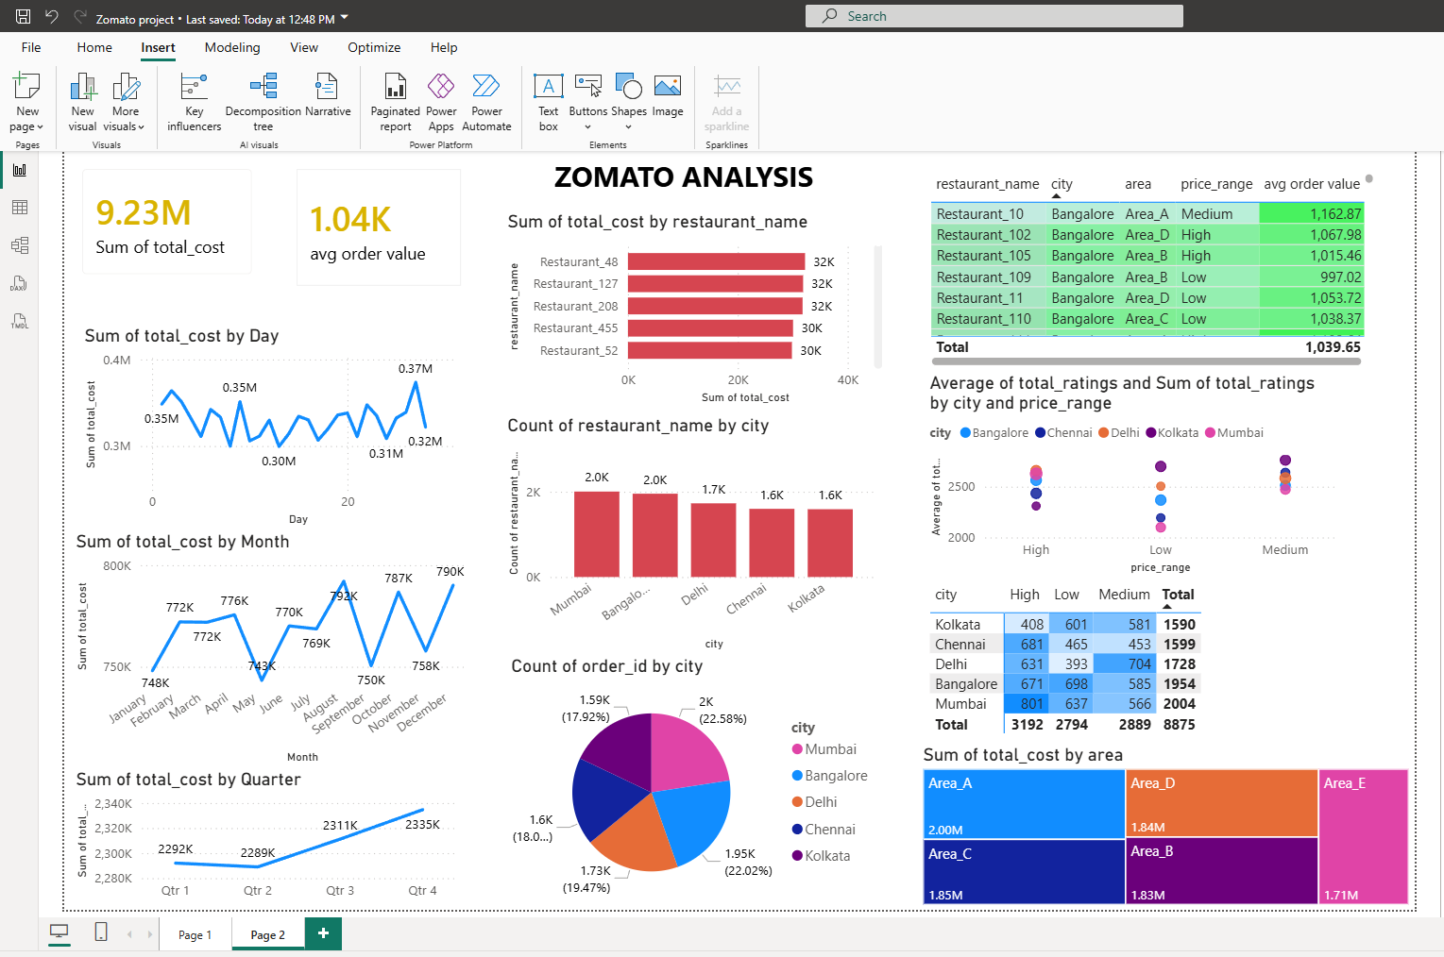
10.DASHBOARD

Slide 12
INSIGHTS:
MUMBAI & DELHI contributes highest order volume and customer engagement.
Revenue trends shows stable and consistent business performance over time.
Premium and highly rated restaurants tend to achieve better sales and customer satisfaction.
Lower performing cities present opportunities for targeted marketing and business expansion.

Slide 13
THANK YOU

